Slide 1
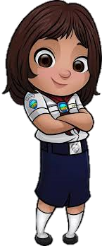


THE HISTORY & PURPOSE AND UNDERSTANDING THE ADVENTURER
Jackie Forss
New Jersey Conference
Adventurer Assoc. State Coordinator
Notes:
Prayer
Introductions (name, church, club name, position)

Slide 2
SESSION OBJECTIVES
To develop an awareness of…
  The mission & uniqueness of the Adventurer Ministry
  It’s relevance to today’s families
Recognize developmental milestones of Adventurer aged children
use knowledge to shape programing and behavior modification techniques
Notes:
To recognize the developmental needs of Adventurers and learn how to deal with them effectively.
To develop an awareness of the mission and uniqueness of the Adventurer Ministry and its relevance to today’s families.
Recognize developmental milestones of Adventurer aged children and use knowledge to shape programing and behavior modification techniques

Slide 3




OVERVIEW
What is The Adventurer Club?
Mission, Objectives Purpose
The Philosophy
The Basics of the Curriculum
a Historical review
Understanding the Adventurer
Q & A

Slide 4

THE BIBLE SAYS…
As leaders we have an awesome responsibility to ensure we do not lead His sheep astray but instead consistently lead them in His direction
If anyone causes one of these little ones--those who believe in me--to
stumble, it would be better for them to have a large millstone hung around their neck and to be drowned in the depths of the sea. Matt. 18:6 NIV
Notes:
As leaders we have an awesome responsibility to ensure we do not lead His sheep astray but instead to always lead them in His direction.
The Bible emphasizing the importance of our leadership roles in Matthew 18:6 and Proverbs 22:6
Additional verses
Eph. 4:6
Luke 17:2
Prov. 22:6
Another survey by the International Bible Society indicated that 83% of all Christians make their first commitment to Jesus between the ages of 4 and 14, that is, when they are children or early youth.
Moral foundations generally determined by age nine

Slide 5

Ice breaker

Slide 6
WHAT IS THE ADVENTURER CLUB?
Scout-like, Faith-based
for children aged 6–9 years
Created by the Seventh-day Adventist Church
Inspired by the Pathfinder Club
Provides opportunities for parents to Learn & grow with their children
Enhances natural abilities
Opens minds to wider world

Slide 7
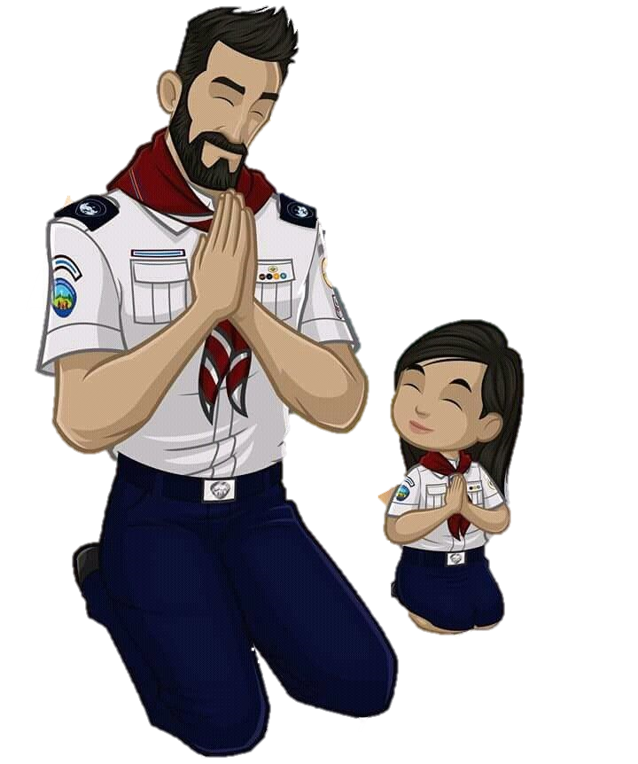


How We Serve
We Serve…
An intercultural community
  pre-K-4th grade
  parents/care–givers
We Offer…
instructional curriculum
family enrichment
supplementary resources
volunteer training
Notes:
We Serve an intercultural community (pre-K-4th grade & their parents/care–givers) through a holistic ministry
The Adventurer ministry offers instructional curriculum, family enrichment, supplementary resources, and volunteer training from within the Seventh-day Adventist® philosophy

Slide 8
OUR MISSION
support parents and care-givers
fulfill the gospel commission (Matthew 28:18-20)
Our success depends on the support of a congregation strong in mission and empowered by the Holy Spirit.
Notes:
To support parents and care-givers in leading and encouraging their children in a growing, joyful love relationship with Jesus Christ.
The Adventurer program should work to fulfill the gospel commission (Matthew 28:18-20).
The success of the program depends on the support of a congregation strong in mission and empowered by the Holy Spirit.

Slide 9

OBJECTIVES
develop Christ-like character
experience joy & satisfaction of Success
express their love for Jesus
learn sportsmanship
strengthen their ability to get along with others
discover God-given abilities
discover God's world
Improve understanding of what makes families strong
develop parental support
Provides a meaningful experience that encourages future participation in youth/teens years (future Pathfinders)
Notes:
develop a Christ-like character
experience the joy & satisfaction of doing things well
express their love for Jesus in a natural way
learn good sportsmanship and strengthen their ability to get along with others
discover their God-given abilities & to learn how to use them to benefit self & serve others
discover God's world
Improve their understanding of what makes families strong
develop parental support
provide a meaningful and exciting experience as the children look forward with anticipation to some day being Pathfinders.

Slide 10

QUESTIONS
&
COMMENTS

Slide 11
Philosophy & Curriculum

Slide 12
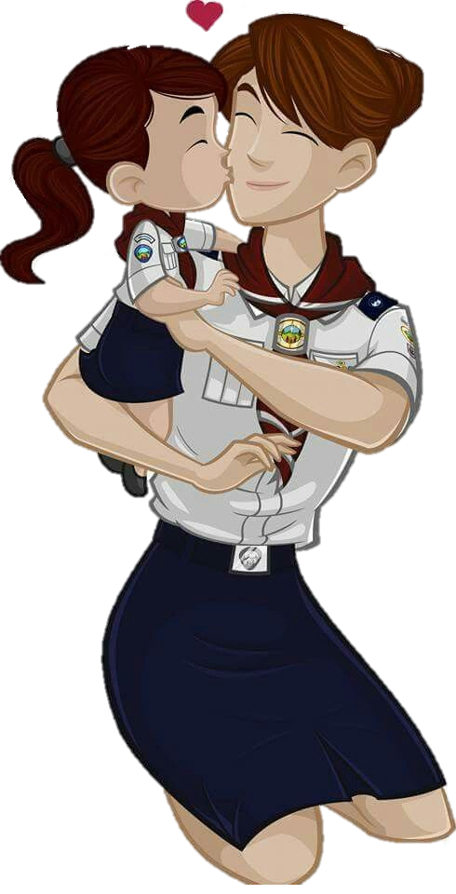
PHILOSOPHY
Created to assist parents
  as a child’s PRIMARY teachers & evangelizers
strengthen the parent/child relationship
Further the child’s development…
  strong relationship with the Lord
  healthy habits
  healthy thoughts & motives
  positive peer group
church, home & school work together w/ parent
Take home message:
“family-focus” contrasting with Pathfinder “peer-focus”
Notes:
Created to assist parents
as a child’s PRIMARY teachers and evangelizers
To strengthen the parent/child relationship
Further the child’s…
Spiritual (develop a strong relationship with the Lord)
Physical (develop healthy habits)
Mental (develop healthy thoughts and motives)
Social development (belong to positive peer group)
The church, home and school can work together with the parent

Slide 13


PHILOSOPHY & CURRICULUM
curriculum is the foundation of the program,
built on the belief that children
  will commit their hearts & lives to Jesus Christ
  acquire habits, skills & knowledge to live for Jesus today.
Notes:
The Adventurer curriculum is the foundation of the program, built on the belief that children will commit their hearts and lives to Jesus Christ and they will acquire habits, skill and knowledge to live for Jesus today.

Slide 14



CURRICULUM
Basic Track
Four Major Tracks
  My God
  My Self
  My Family
  My World
Notes:
There are four major tracks to every level (My God, My Self, My Family and My World).
These major tracks are focused around four basic relationships in a child’s life.
Each of these six tracks is further divided into three separate components.

Slide 15
CURRICULUM
Children Will…
commit their hearts and lives to Jesus Christ.
gain a positive attitude toward the benefits, joys, and responsibilities of living a Christian life.
acquire the habits, skills and knowledge needed to live for Jesus today.
Parents and other primary caregivers will…
become more confident and effective in their role as collaborators with Christ for their children.
Church will…
accept its responsibility in assisting to care for its youth by providing and implementing a planned curriculum of religious education for this age level.
Notes:
Children will, at their own level, commit their hearts and lives to Jesus Christ.
Children will gain a positive attitude toward the benefits, joys, and responsibilities of living a Christian life.
Children will acquire the habits, skills and knowledge needed to live for Jesus today.
Parents and other primary caregivers will become more confident and effective in their role as collaborators with Christ for their children.
Church will accept its responsibility in assisting to care for its youth by providing and implementing a planned curriculum of religious education for this age level

Slide 16
QUESTIONS
&
COMMENTS

Slide 17
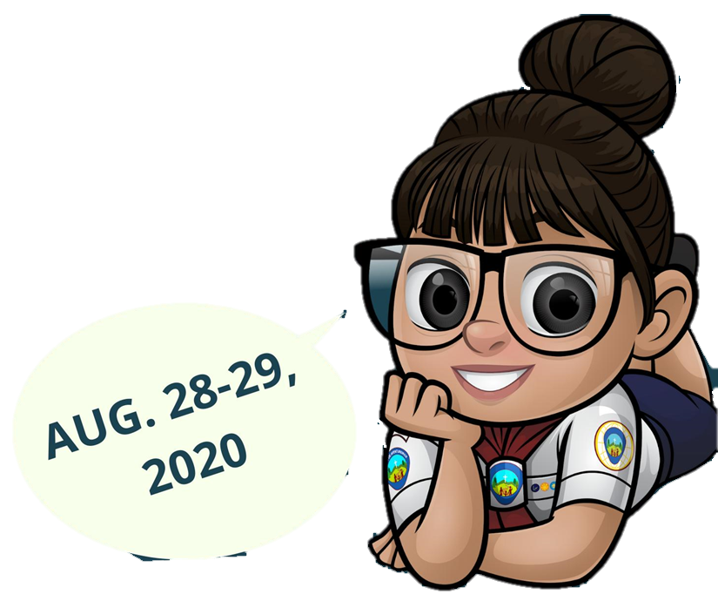



Through the Years
A Historical Overview
This is how it all began

Slide 18



ADVENTURER PLEDGE AND LAW
  Pledge: Because Jesus loves me, I can always do my best
  Law: Jesus can help me to:
Be obedient
Be pure
Be true
Be kind
Be respectful
Be attentive
Be helpful
Be cheerful
Be thoughtful
Be reverent

Slide 19
Original adventurer song
Adventurers for Jesus, this our earnest prayer.
Adventurers for Jesus, home, at school, at play and everywhere.
We’ll tell the world of life in Jesus; He is all our song.
There is all you need in Jesus.
Won’t you come along?

Slide 20

ADVENTURER SONG
  We are Adventurers,
  At home, at school, at play.
  We are Adventurers,
  We're learning every day
  To be honest, kind, and true,
  To be like Jesus
  through and through!
  We are Adventurers!
Notes:
2006 Word change
created by: Joann M. Herrington

Slide 21
HISTORY OF THE ADVENTURER CLUB
Adventurer Club roots reach back to the early days of children’s ministry in the Seventh-day Adventist Church.
1890’s Our Little Friend is published
1917 Primary Reading Course developed
1930 Introduction Pre-JMV classes (Busy Bee, Sunbeam, Builder, & Helping Hand).
annual investitures held with JMV investitures.
1939 The General Conference endorsed the 4 classes.
1957 Primary Treasure is published
Notes:
1890’s Our Little Friend is published
1917 Primary Reading Course developed for young children
1930 Introduction Pre-JMV classes (Busy Bee, Sunbeam, Builder, and Helping Hand). Special pin, scarf and slide annual investitures held with JMV investitures.
1939 The General Conference endorsed the four classes.
1957 Primary Treasure began to be published

Slide 22
HISTORY OF THE ADVENTURER CLUB
1972 WA Conf. “Beavers,”
1975 North-Eastern Conf.- children’s club concept program
1980 “Pre-Pathfinders," "Adventurers," or "Beavers“
1988 NAD formalize Adventurers Club. Curriculum
1989 Updated curriculum, authorized 4 classes, aligned with school grades,, developed awards, updated guidelines
1990 NAD began Pilot Adventurer program
Notes:
1972 WA Conf. “Beavers,” forerunner of Adventurers
1975 North-Eastern Conf.- children’s club concept program
1980 “Pre-Pathfinders," "Adventurers," or "Beavers“
1988 NAD formalize Adventurers Club. Curriculum written by Teresa Reeve
1989 Update curriculum, authorized four classes, aligned with school grades/age groups, developed awards, update guidelines & curriculum
1990 NAD began Pilot Adventurer program (North Eastern Conf. ‘75)

Slide 23
HISTORY OF THE ADVENTURER CLUB
1991 GC authorized a global program
GC expanded - Little Lambs & Eager Beaver
Names/levels vary (languages and regions).
South Pacific Division (no native beavers), age 5 “Little Fish”
1993 Adventurer Club officially recognized in NAD; Eager Beaver program re-piloted
2000 GC voted, Club Director now Church Board member;
NAD creates a department for Youth Ministries including Adventurers with Pastor James Black as the Director
Notes:
1990 - Master plan of the Adventurers Club was started in the North American Division. In 1975 the North-eastern.
1991 - the General Conference of Seventh-day Adventist Church authorized a global program, setting goals, curriculum, flag, uniform and ideals.
Based on work by the Florida Conference the Adventurer Club program expanded to cover:
Little Lambs-Pre-K/Age 4
Eager Beaver-Kindergarten/Age 5
The names of the levels may vary in different languages and regions. For example in the South Pacific Division, where there are no native beavers, the Age 5 group is called Little Fish.

Slide 24
HISTORY OF THE ADVENTURER CLUB
2004 NAD Adventurer Committee Adopts Eager Beaver & Little Lamb
2006 Eager Beaver manual is copyrighted;
Eager Beaver, & Little Lamb songs adopted & copyrighted by the General Conference
2007 Little Lamb manual created and copyrighted
2016 Little Lamb & Eager Beavers available worldwide after GC Youth Ministries Global Youth Directors Vote
Notes:
2004 Eager Beaver and Little Lamb programs are adopted by the NAD Adventurer Committee
2006 Eager Beaver manual is copyrighted; new Adventurer, Eager Beaver, and Little Lamb songs adopted and copyrighted by the General Conference
2007 Little Lamb manual created and copyrighted
2016 Little Lamb and Eager Beavers now available worldwide after a GC Youth Ministries Global Youth Directors vote.

Slide 25

Where Are We Now?
NAD adopted six levels and new logo
New Jersey Conference
  Adventurers – original 4 levels
  Discover – 4 levels
  (include Little Lambs & Eager Beavers).
Notes:
NEWS UPDATE!
Up until 2016, Little Lamb and Eager Beavers was only available in the North American Division. However, based on recent GC Youth Ministries Global Youth Directors vote, it is going global! Pray for the leadership team as they work to make the requirements and information global in scope and sequence! Yes, your hard work and ministry excellence has allowed this curricula to "go viral." Thank you for your leadership!
Here is the news note from GC Youth Ministries (P1 - July 2016)
BIG NEWS ABOUT ADVENTURERS!
During our quinquennium advisory on global youth ministry, the advisory members carried a vote to officially add the Little Lamb and Eager Beaver levels to the Adventurers ministry, bringing the total number of levels to six. Streamlining the ministry in this way means the official ages for the Adventurer ministry are now 4-9 years old. Having six levels also required changing the previous Adventurer logo, since it incorporated within it the respective logos for four Adventurer classes. We will soon be pleased to release to the public the image files of the new logo, a more in-depth explanation as to the reasons behind the changes and what they mean for the local church. Please follow our social media accounts to receive notification when the new resources being created by our department are available to share worldwide. If you have any questions or comments, please don't hesitate to email our department at youth@gc.adventist.org.

Slide 26

NAD CURRICULUM
Levels
  Little Lamb – age 3-4
  Eager Beaver – Kindergarten
  Busy Bee - 1st grade
  Sunbeam - 2nd grade
  Builder - 3rd grade
  Helping Hand - 4th grade
Notes:
The Adventurer curriculum is divided into six/four levels.
Busy Bee level is designed for first-graders.
Sunbeam level for second-graders.
Builder for third-graders
Helping Hand level for fourth-graders.
Each level builds on the levels which came before it and is especially designed to interest, challenge, and provide successful experiences for children of that grade level.
To ensure that the children have the background necessary to receive maximum benefit from the Adventurer program.

Slide 27
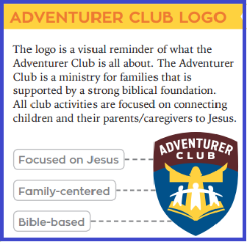



NAD Logo
Notes:
2015

Slide 28
QUESTIONS
&
COMMENTS

Slide 29
Understanding the Adventurer:
Development & discipline

Slide 30


WHAT to expect
They LOVE…
  strenuous activities!
  creating new things!
  hearing stories!
They have…
  active imaginations
  growing ability to memorize!
  variable attention spans
They CRAVE new experiences
They are CURIOUS!

Slide 31


Physical Characteristics
BOUNDLESS energy
developing coordination
Mental Characteristics
learn by doing
curious about EVERYTHING!
understand what they see & touch
use imagination
can memorize easily
like variety

Slide 32


Spiritual Characteristics
learning right from wrong
motivated more if it’s about me!
soak up Biblical knowledge
Social Characteristics
learning social skills
Exercising independence
Eager for approval
need success
can easily get overexcited!
VERY social
Notes:
Spiritual Characteristics
concerned about learning right from wrong
still motivated more if it’s about me!
soak up Biblical knowledge
Social Characteristics
learning social skills
becoming more independent
need approval from you
need success
can easily get overexcited!
VERY social

Slide 33


Development
Eager/excited to learn
School-age kids flourish socially
developing stronger friendships
developing new interests/hobbies
Increased resistance to instructions
Defiance/testing limits
Notes:
Milestones and Parenting Tips for Child Development (verywellfamily.com)
https://www.verywellfamily.com/child-development-overview-4172261
Eager/excited to learn
School-age kids flourish socially
develop stronger friendships
develop new interests and hobbies
more resistance when given instructions
Defiance can be common as the child tests the limits

Slide 34
HOW WE RESPOND
Provide physical activity!
Be PATIENT!
Get them involved
Think “hands-on”
Make stories VIVID
age-appropriate expectations
Adapt & tailor to meet their needs
Use visual aids and items they can manipulate
Keep the story moving!
Modify to include movement
Let them choose an activity
Reward GOOD behavior
Discreetly implement behavior modification
Notes:
Make stories VIVID with details that stimulate their minds (ask them to close eyes and picture themselves in the story)
Don’t make requirements impossible

Slide 35
DISCIPLINE
Provides a positive contribution to the child’s happiness and well-being.
helps the child learn self-control & caring for others as a disciple of Jesus
should include positive & negative consequences.
  Use negative (Ex. removing a privilege) when rules are broken (safety)
Notes:
Providing discipline is a positive contribution to the child’s happiness and well-being.
Discipline is, but a way of helping the child to learn self-control and caring for others as a disciple of Jesus
Discipline should include positive and negative consequences. Use a negative consequence, like removing a privilege, when they break the rules.

Slide 36
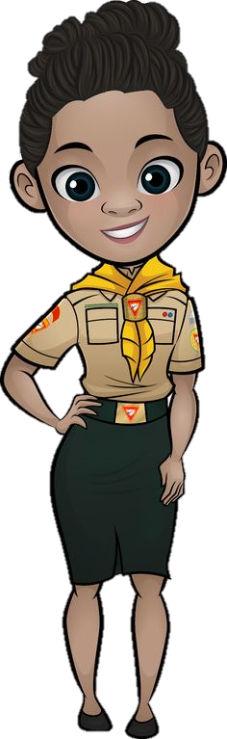
DISCIPLINE
Model the behavior you want (Engage TLT’s or Pathfinders)
Provide a peaceful, organized atmosphere
Be prepared
Set specific, age-appropriate expectations
Consistently redirect misbehavior
Notes:
Model the behavior you want, praise the good behavior you see
Be organized – preparation is key to providing peaceful atmosphere
Set expectations – age appropriate – knowing expectations decreases negative behavior
When redirecting misbehavior be consistent – choose your battles – focus on one behavior at a time

Slide 37
Positive reinforcement
effective behavior modification technique
encourages prosocial behaviors
prevents misbehavior
encourages & motivates children to be responsible
Notes:
When a child misbehaves, rewards might be the last thing on your mind, but positive reinforcement…
Can be one of the most effective behavior modification techniques.
Can encourage prosocial behaviors (sharing or following directions)
Can prevent misbehavior (hitting and rule violations)
Can also be an effective way to encourage and motivate children to be responsible, (get along with others, or complete homework without arguing).

Slide 38
Examples of Positive Reinforcement
doesn’t need to be a tangible item
Clapping and cheering
Giving a high five
Giving a thumbs-up
Offering a special activity, like playing a game or reading a book together
Offering praise
Telling another adult how proud you are of your child’s behavior while your child is listening
giving a child extra privileges or tangible rewards
Notes:
You can also offer positive reinforcement by giving a child extra privileges or tangible rewards.²
﻿ For example, if your child cleans their room without being asked, you could take them to the playground as a reward. Chances are that they'll be more motivated to clean their room again. If your child patiently helps their sibling with their homework, you could offer more time to play video games.
There are many different types of reward systems you can use to aid positive reinforcement as well. Younger children often do well with sticker charts and older children often respond well to token economy systems.³﻿
It's important to reward your child's efforts and improvement, rather than focusing only on perfect results. If you see them try or if they did better than last time, let them know you notice.
For example, if you are encouraging your child to put away their school things when they come home and you see that your child hangs up their coat but forgets to put their lunchbox on the counter, you can still praise the partial success. Similarly, if they start walking to the bathroom when you direct them to brush their teeth but

Slide 39
Schedules of Reinforcement
Encouraging new behavior/working on a specific skill.
  Consistently offer positive reinforcement
  given randomly, behavior is unlikely to change.
Rewards are Not necessary every time
  However, (the more often their good behavior is noticed, the better
Consider providing immediate reinforcement
Over time, space out your reinforcement.
  Once skill has been mastered, surprise reinforcement is effective maintenance.
The more you offer praise, the more motivated a child will be to repeat the behavior.
Notes:
When your child is learning a new behavior or working on a specific skill, it's important to offer positive reinforcement on a consistent basis. After all, how often would you go to work if you only got paid occasionally? You might give up at some point because you'd decide your efforts aren't worthwhile.
The same can be said for your child. If you only catch them being good once in a while or you only give them positive reinforcement randomly, their behavior is unlikely to change.
This doesn’t mean that you need to offer your child a reward every time they carry a dish to the sink. However, especially for younger kids, the more often their good behavior is noticed, the better.
To avoid a constant divvying out of physical rewards, you can set up a reward system where you provide immediate reinforcement in the form of a sticker or token. Then, stickers and tokens can later be exchanged for bigger rewards, such as a new book or an ice cream cone.3﻿
Over time, you can space out your reinforcement. Once your child has mastered a skill, surprise reinforcement from time to time can be effective maintenance. Say, "Wow, I'm so impressed you've been getting ready for school on time lately. I think we'll go to the playground tonight to celebrate."
The more often you can offer praise, the more motivated your child will be to repeat the behavior.

Slide 40
Connect Rewards to Behavior
Goal: Teach the child that positive behavior makes good things happen.
Examples:
  good sport after loss, earns privilege to choose the next game.
  shares their toy/playing nicely, earns additional play time
Connect reinforcement & behavior = makes positive consequence more memorable & effective
When child chooses the reward they will earn
  provides ownership & buy-in
  increases motivation.
Notes:
If you are offering rewards along with praise, aim to connect them to the behavior you seek to reinforce. You want your child to see that exhibiting positive behavior makes good things happen.
For example, if your child helps you prepare dinner, you can let them decide which dressing to put on the salad—or what type of dessert to serve. If your child is a good sport about losing a game, you can let them choose the next game. If your child shares their toy with their sibling, you can let them stay up a bit later to keep playing—since they are playing together so nicely.
This connection between the reinforcement and the behavior will make the positive consequence more memorable and effective.
Additionally, you can offer your child the choice of what reward they would like to earn for consistently showing the selected behavior. This approach gives the child a greater sense of agency and buy-in, which will likely become another source of motivation.
connect the reward to the behavior you seek to reinforce. Lesson - exhibiting positive behavior makes good things happen.
Examples:
good sport about losing a game, let them choose the next game.
shares their toy, you can let them stay up a bit later to keep playing—since they are playing together so nicely.
connecting the reinforcement and the behavior = more memorable and effective.
offer a choice of what reward they would like to earn for consistently showing the selected behavior. This approach gives the child a greater sense of agency and buy-in = increased motivation.

Slide 41

Behaviors to Reinforce
good friend/good sport
Completing chores
Immediate Compliance
Compromising/being flexible
Handling a disagreement/disappointment without a tantrum
Helping without complaint
Playing nicely/quietly
Putting in a lot of effort on a difficult task
Showing compassion
Talking about their feelings
Using manners
Waiting patiently
Notes:
Use positive reinforcement to encourage any behaviors that you want your child to repeat. Examples of behaviors to reinforce include:
Being a good friend or a good sport
Completing chores
Complying with a request right away
Compromising or being flexible
Handling a disagreement or disappointment without a tantrum
Helping you without complaint
Playing nicely or quietly
Putting in a lot of effort on a difficult task
Showing compassion
Talking about their feelings
Using manners
Waiting patiently

Slide 42


Safety
Each director or counselor must accept the moral obligation of protecting from physical injury those who are under his/her care.
Adventurer leaders must educate themselves to observe and recognize potential hazards.

Slide 43
Questions, Answers, Discussion

Slide 44
Club Strategies
Candles
Lollipop stand
Marble Jar
Identify the positive opposite
High five reward
Stop and think
Notes:
Ideas shared by participants who are attending the training
Candles – light at the beginning of class, light continues to burn when children behave – if candle is burned down then they get a party - Odun
Lollipop stand – all children earn a lollipop if everyone was behaving during the club meeting (Social pressure) rewarding positive behavior - Tiina
Marble jar- marbles are placed in one jar and moved when children are following the rules or misbehaving – rewards are given when marbles fill up the “positive jar” - Odun
Dr. Roger Harrison
Identify the positive opposite - Identity the behavior you want to correct and then find the opposite – if you want kids to stay in their seats, give verbal praise to children who are sitting nicely , do not give attention to the children who are getting up.
High five reward – trace the child’s hand , write down the behavioral instruction you want to the child to focus on during a certain time period at the top of the page (Use kind hands, walk beside me, use kind words, etc.). Do not write down what you don’t want them to do., for example (Don’t run, don’t hit, no name calling).
Stop and think – Instructor uses green light, yellow light, red light, undesirable behavior – consequence moving to yellow or red light. Child writes down what they have done and explains what they could have done differently– parents sign

Slide 45
Idea Swap
Notes:
Share strategies they have used in with their clubs/own children/sabbath school, etc.

Slide 46



Suggested Reading Materials
Notes:
The Incredible Years – Carolyn Stratton, PhD
Raising an emotionally intelligent child, The Heart of Parenting – John Gottman, PhD

Slide 47
Questions, Answers, Discussion

Slide 48
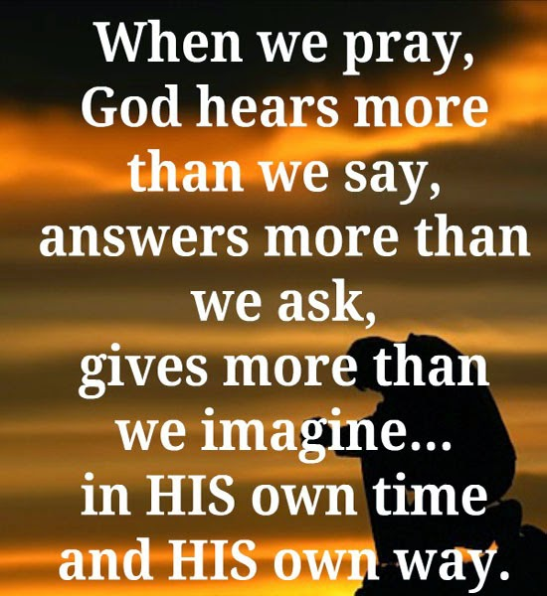
CLOSING PRAYER
This Photo by Unknown Author is licensed under CC BY

